Slide 1
Discrete Mathematics
South China University of Technology
1

Slide 2
Chapter 8. Graphs
Shortest-Path Problems
Section 8.6
2

Slide 3
Contents
1
Shortest Path Problems
2
Dijkstra’s Algorithm
3
The traveling salesman problem
3

Slide 4
Shortest Path Problems
4

Slide 5
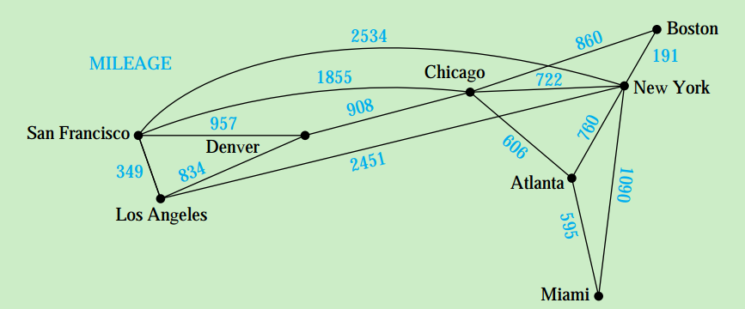
Introduction
Many problems can be modeled using graphs with weights assigned to their edges.
Problems involving distances can be modeled by assigning distances between cities to the edges.

Slide 6
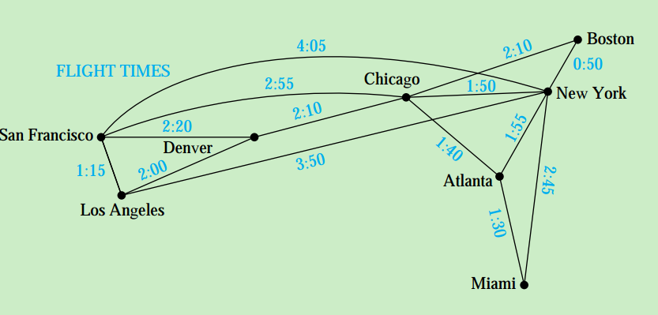
Problems involving flight time can be modeled by assigning flight time to the edges.

Slide 7
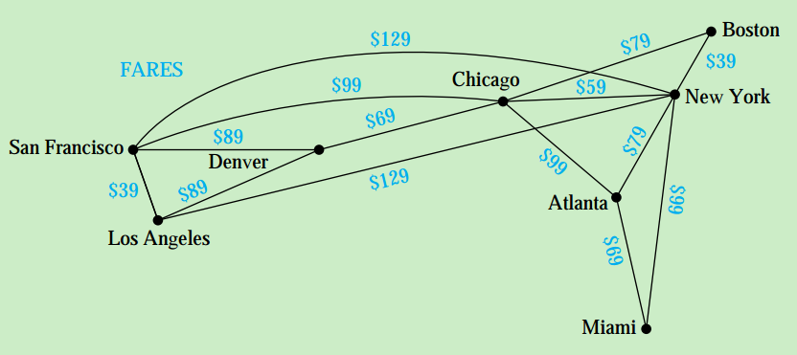
Problems involving fares can be modeled by assigning fares to the edges.

Slide 8
Dijkstra’s Algorithm
8
8

Slide 9
A Shortest-Path Algorithm
There are several different algorithms that find a shortest path between two vertices in a weighted graph.
This section will present the classical algorithm: Dijkstra’s Algorithm proposed by Dutch mathematician Edsger Dijkstra.

Slide 10
3
4
2
b
c
3
a
z
2
1
d
3
e
The only paths starting at a that contain no vertex other than a (until the terminal vertex is reached) are (a, b) and (a, d).
Since the lengths of (a, b) and (a, d) are 4 and 2, d is the closest vertex to a.

Slide 11
3
4
2
b
c
3
a
z
2
1
d
3
e
We can find the next closest vertex by looking at all paths that go through only a and d.
The shortest such path to b is still a, b, with length 4, and the shortest such path to e is a, d, e, with length 5. So the next closest vertex to a is b.

Slide 12
3
4
2
b
c
3
a
z
2
1
d
3
e
For the next closest vertex to a, we need to examine only paths that go through only a, d, and b (until the terminal vertex is reached).
There is a path of length 7 to c, namely a, b, c and a path of length 6 to z, namely, a, d, e, z. So z is the next closest vertex to a, and its length is 6.

Slide 13
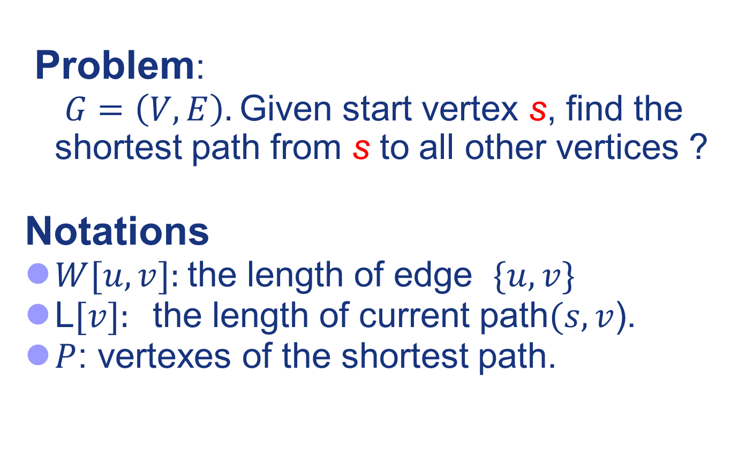
Dijkstra’s idea
Problem:
$G=\left(V, E\right).$Given start vertex s, find the shortest path from s to all other vertices ?
Notations
$W[u, v]:$the length of edge $\{u, v\}$
L$[v]:$the length of current path$(s,v$).
$P$: vertexes of the shortest path.
Notes:
This solution is known as Dijkstra’s algorithm

Slide 14
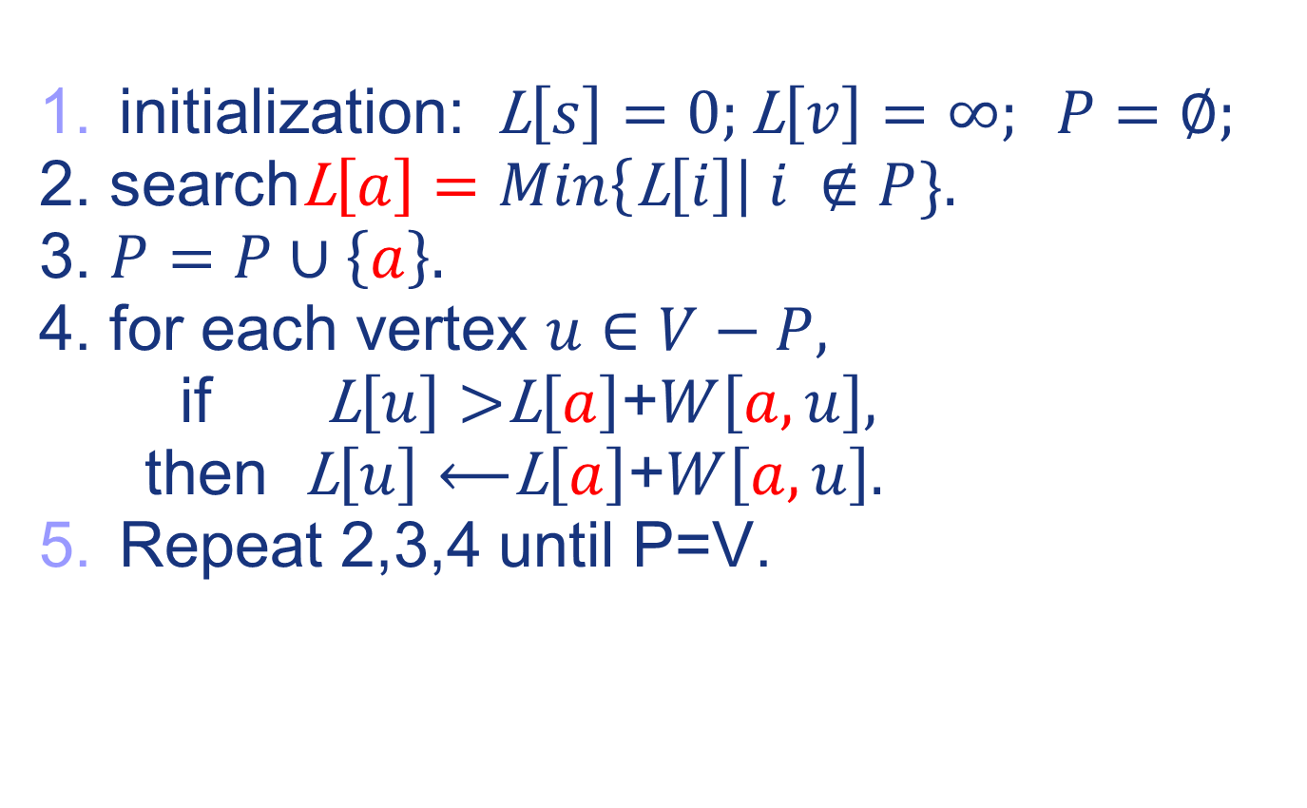



Dijkstra’s idea
initialization: L$\left[s\right]=0;\text{L}\left[v\right]=∞; P=∅;$
2. search$\text{L}\left[a\right]=Min\left\{\text{L}\left[i\right]\right| i ∉P\}.$
3. $P=P∪\left\{a\right\}.$
4. for each vertex $u∈V−P,$
if $\text{L}\left[u\right]>$L$\left[a\right]$+$W\left[a,u\right],$
then L$\left[u\right]⟵$L$\left[a\right]$+$W\left[a,u\right].$
Repeat 2,3,4 until P=V.
u
a
$$W\left[a,u\right]$$
$$\text{L}\left[a\right]$$
s
$$\text{L}\left[u\right]$$
Notes:
This solution is known as Dijkstra’s algorithm

Slide 15
Example 2
∞
∞
5
b
d
6
P:=Ø
L(vi):
=∞, if vi ≠a
=0 , if vi=a
4
∞
0
8
a
1
2
z
2
3
10
c
e
∞
∞

Slide 16
Example 2
4(a)
∞
b
d
5
6
4
0
8
a
1
2
z
∞
2
3
10
c
e
2(a)
∞
u:=a vertex not in P with L(u) minimal
P:= P U {u}

Slide 17
Example 2
3(a,c)
10(a,c)
b
d
5
6
4
0
8
a
1
2
z
∞
2
3
10
c
e
12(a,c)
2(a)
if L(u)+w(u,v) < L(v) then
L(v):=L(u)+w(u,v)

Slide 18
Example 2
3(a,c)
8(a,c)
b
d
5
6
4
0
8
a
1
2
z
∞
2
3
10
c
e
2(a)
12(a,c)
if L(u)+w(u,v) < L(v) then
L(v):=L(u)+w(u,v)

Slide 19
Example 2
3(a,c)
8(a,c,b)
b
d
5
6
4
0
8
a
1
2
z
14(a,c,b,d)
2
3
10
c
e
10(a,c,b,d)
2(a)
if L(u)+w(u,v) < L(v) then
L(v):=L(u)+w(u,v)

Slide 20
Example 2
3(a,c)
8(a,c,b)
∞
b
d
5
6
4
0
8
a
1
2
z
13(a,c,b,d,e)
2
3
10
c
e
10(a,c,b,d)
2(a)
if L(u)+w(u,v) < L(v) then
L(v):=L(u)+w(u,v)

Slide 21
Example 2
3(a,c)
8(a,c,b)
b
d
5
6
4
0
8
a
1
2
z
13(a,c,b,d,e)
2
3
10
c
e
2(a)
10(a,c,b,d)
The shortest path is a, c, b, d, e, z with length 12.

Slide 22
Theorem 1: Dijkstra’s algorithm finds the length of a shortest path between two vertices in a connected simple undirected weighted graph.
Theorem 2: Dijstr’s algorithm uses O(n^2) operation (additions and comparisons) to find the length of shortest path between two vertices in a connected simple undirected weighted graph with n vertices.

Slide 23
The traveling salesman problem
23
23

Slide 24
Traveling salesman problem
TSP Problem: A traveling salesman wants to visit each of n cities exactly once and return to his starting point. In which order should he visit these cities to travel the minimum total distance?
shortest Hamilton circuit.
For a n cities TSP problem, there are
(n-1)!/2 different Hamilton circuits to examine.

Slide 25
C
113
A
137
142
98
147
56
5 vertices
5 cities
4!/2=12
Hamilton circuits
135
E
58
B
133
D

Slide 26
For a TSP of 25 cities, the problem will have 25 vertices, and a total of 24!/2 different Hamilton circuits.
If it took just one nanosecond ( second) to examine each Hamilton circuit, the required time would be approximately ten million years.

Slide 27
Since the traveling salesman problem has both practical and theoretical importance, a great deal of effort has been devoted to devising efficient algorithms that solve it.
However, no algorithm with polynomial worst-case time complexity is known for solving this problem.
Furthermore, if a polynomial worst-case time complexity algorithm were discovered for TSP, many other difficult problems would be also solved. NPC

Slide 28
2
7. a)

Slide 29
End of Section 8.6
Click to edit company slogan .
29

